Slide 1


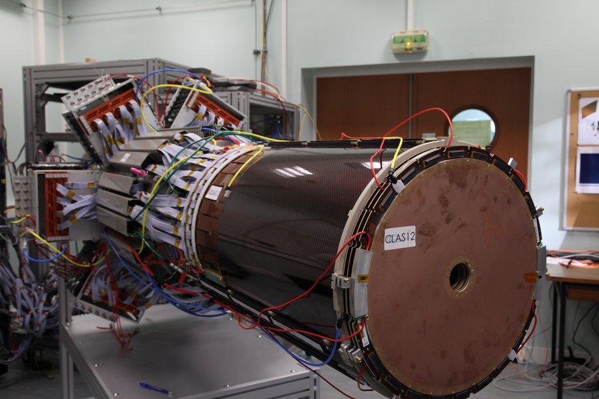

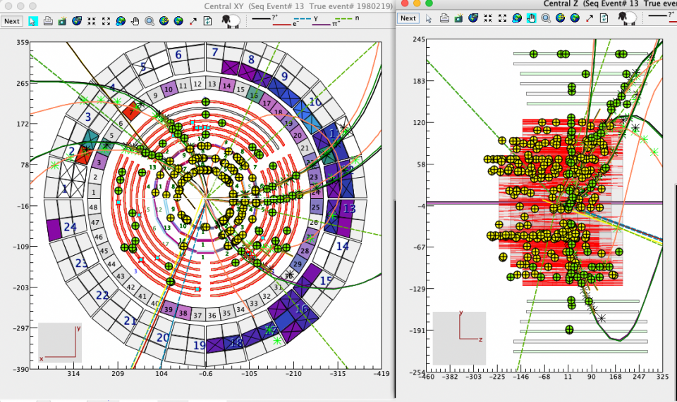
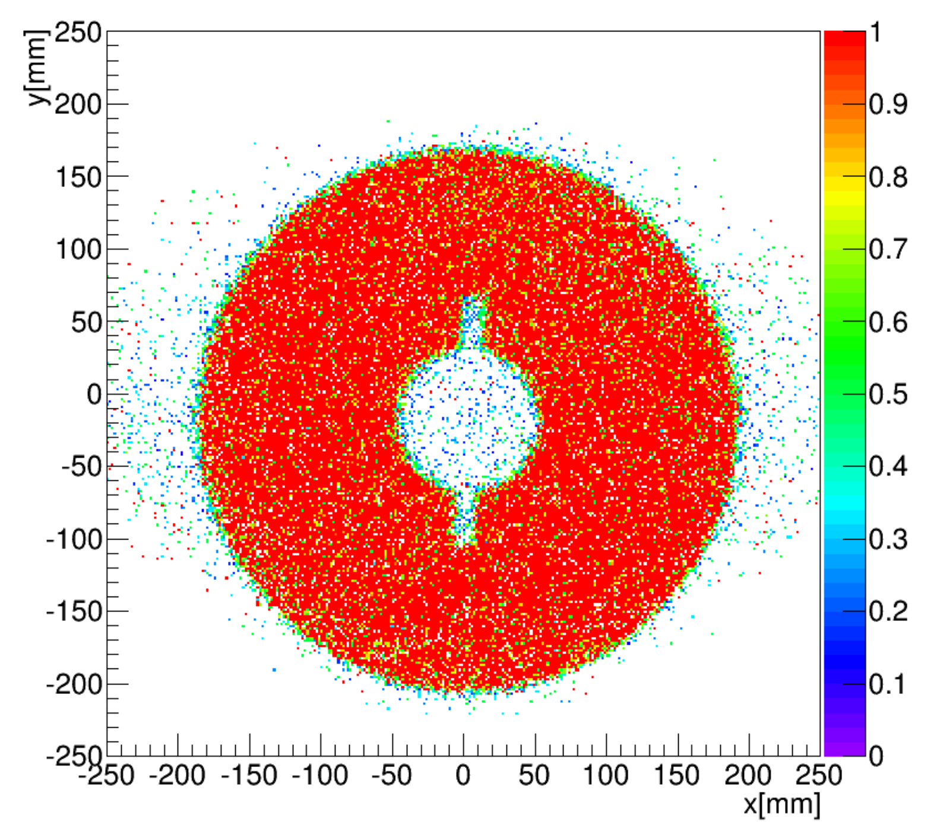
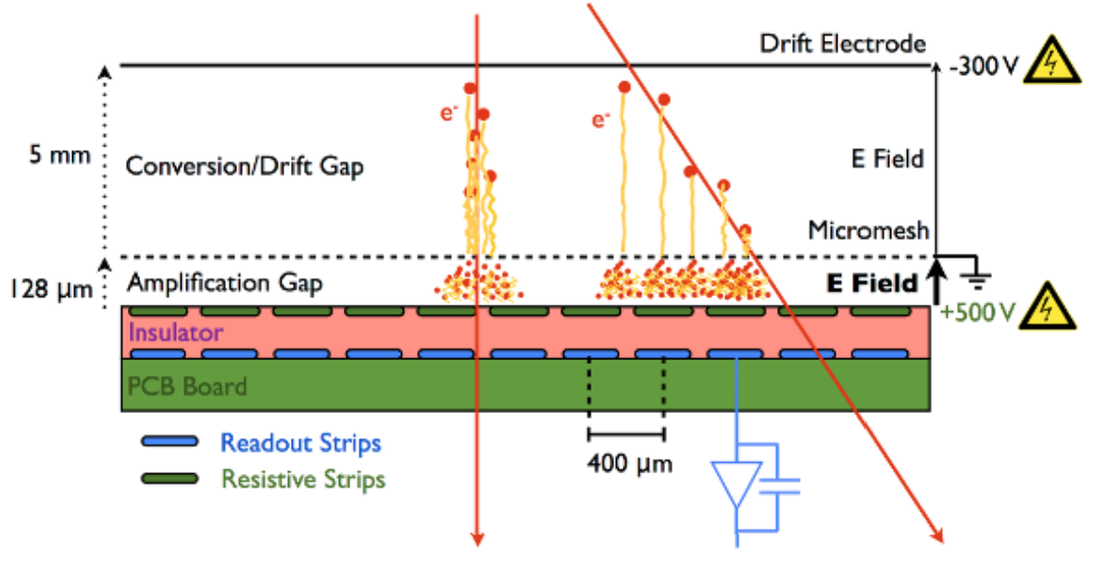
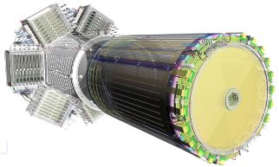
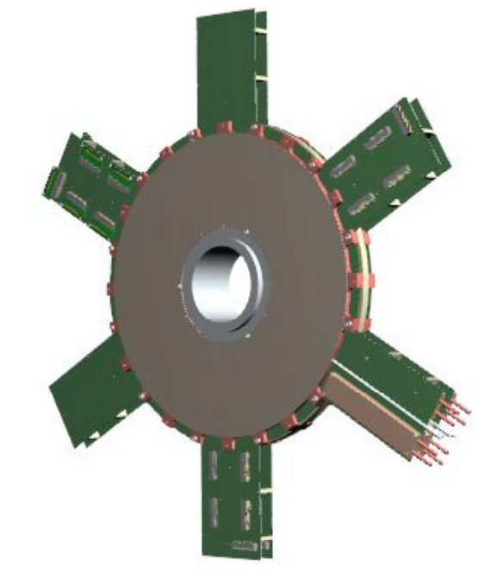
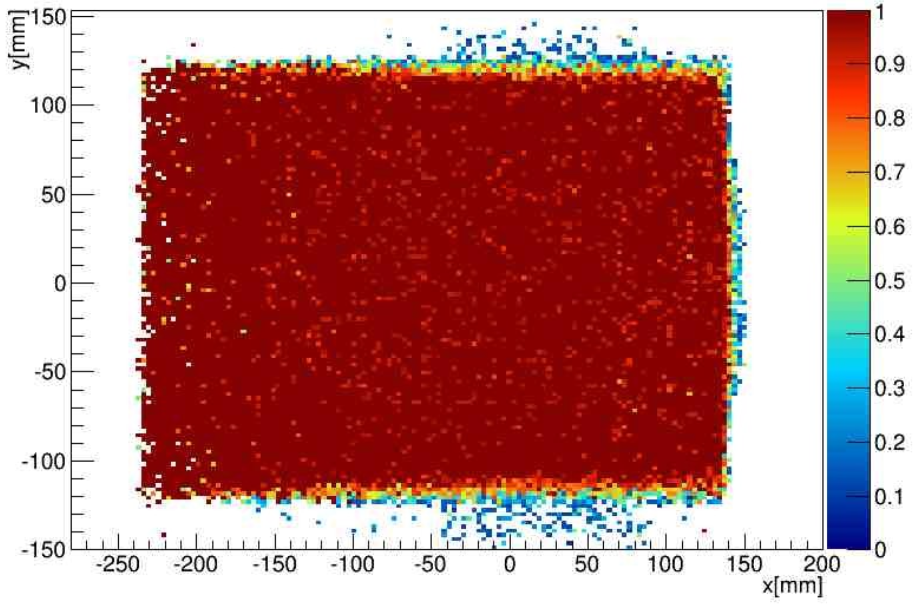
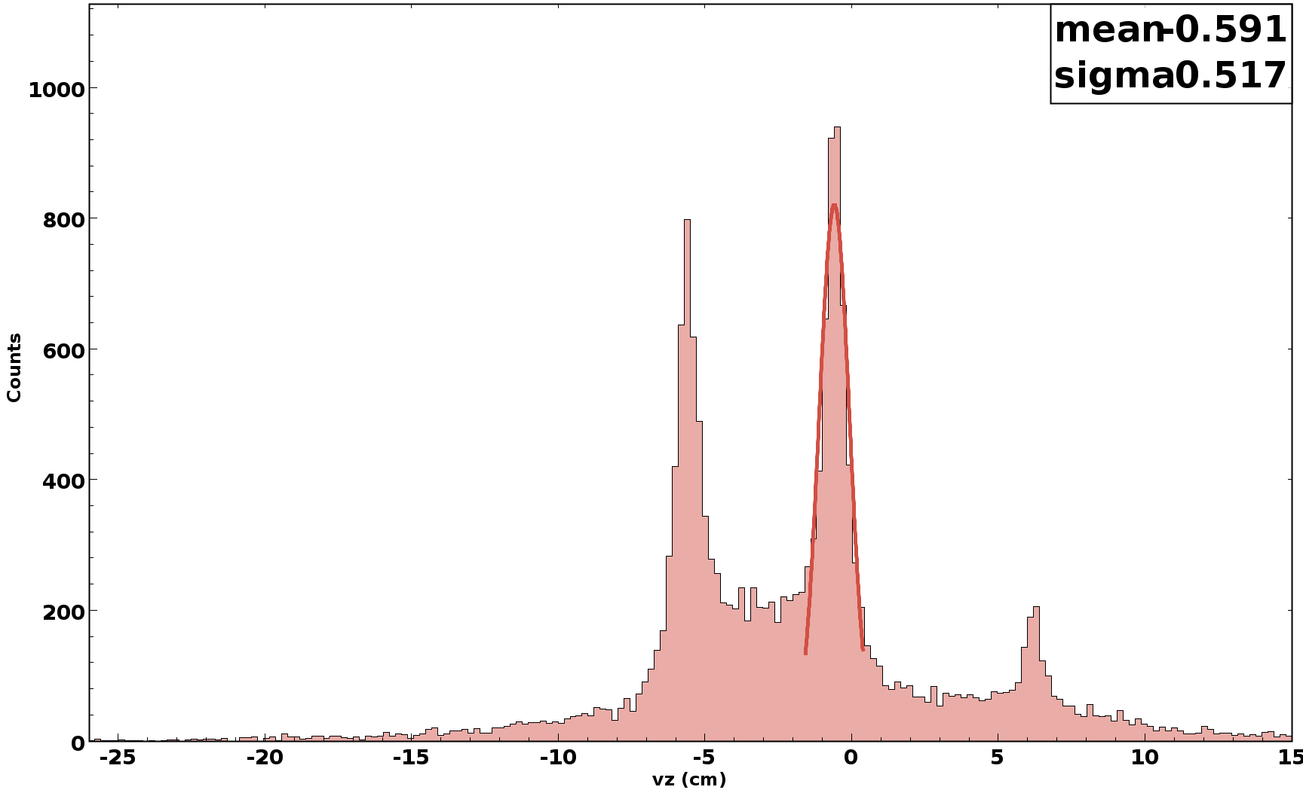
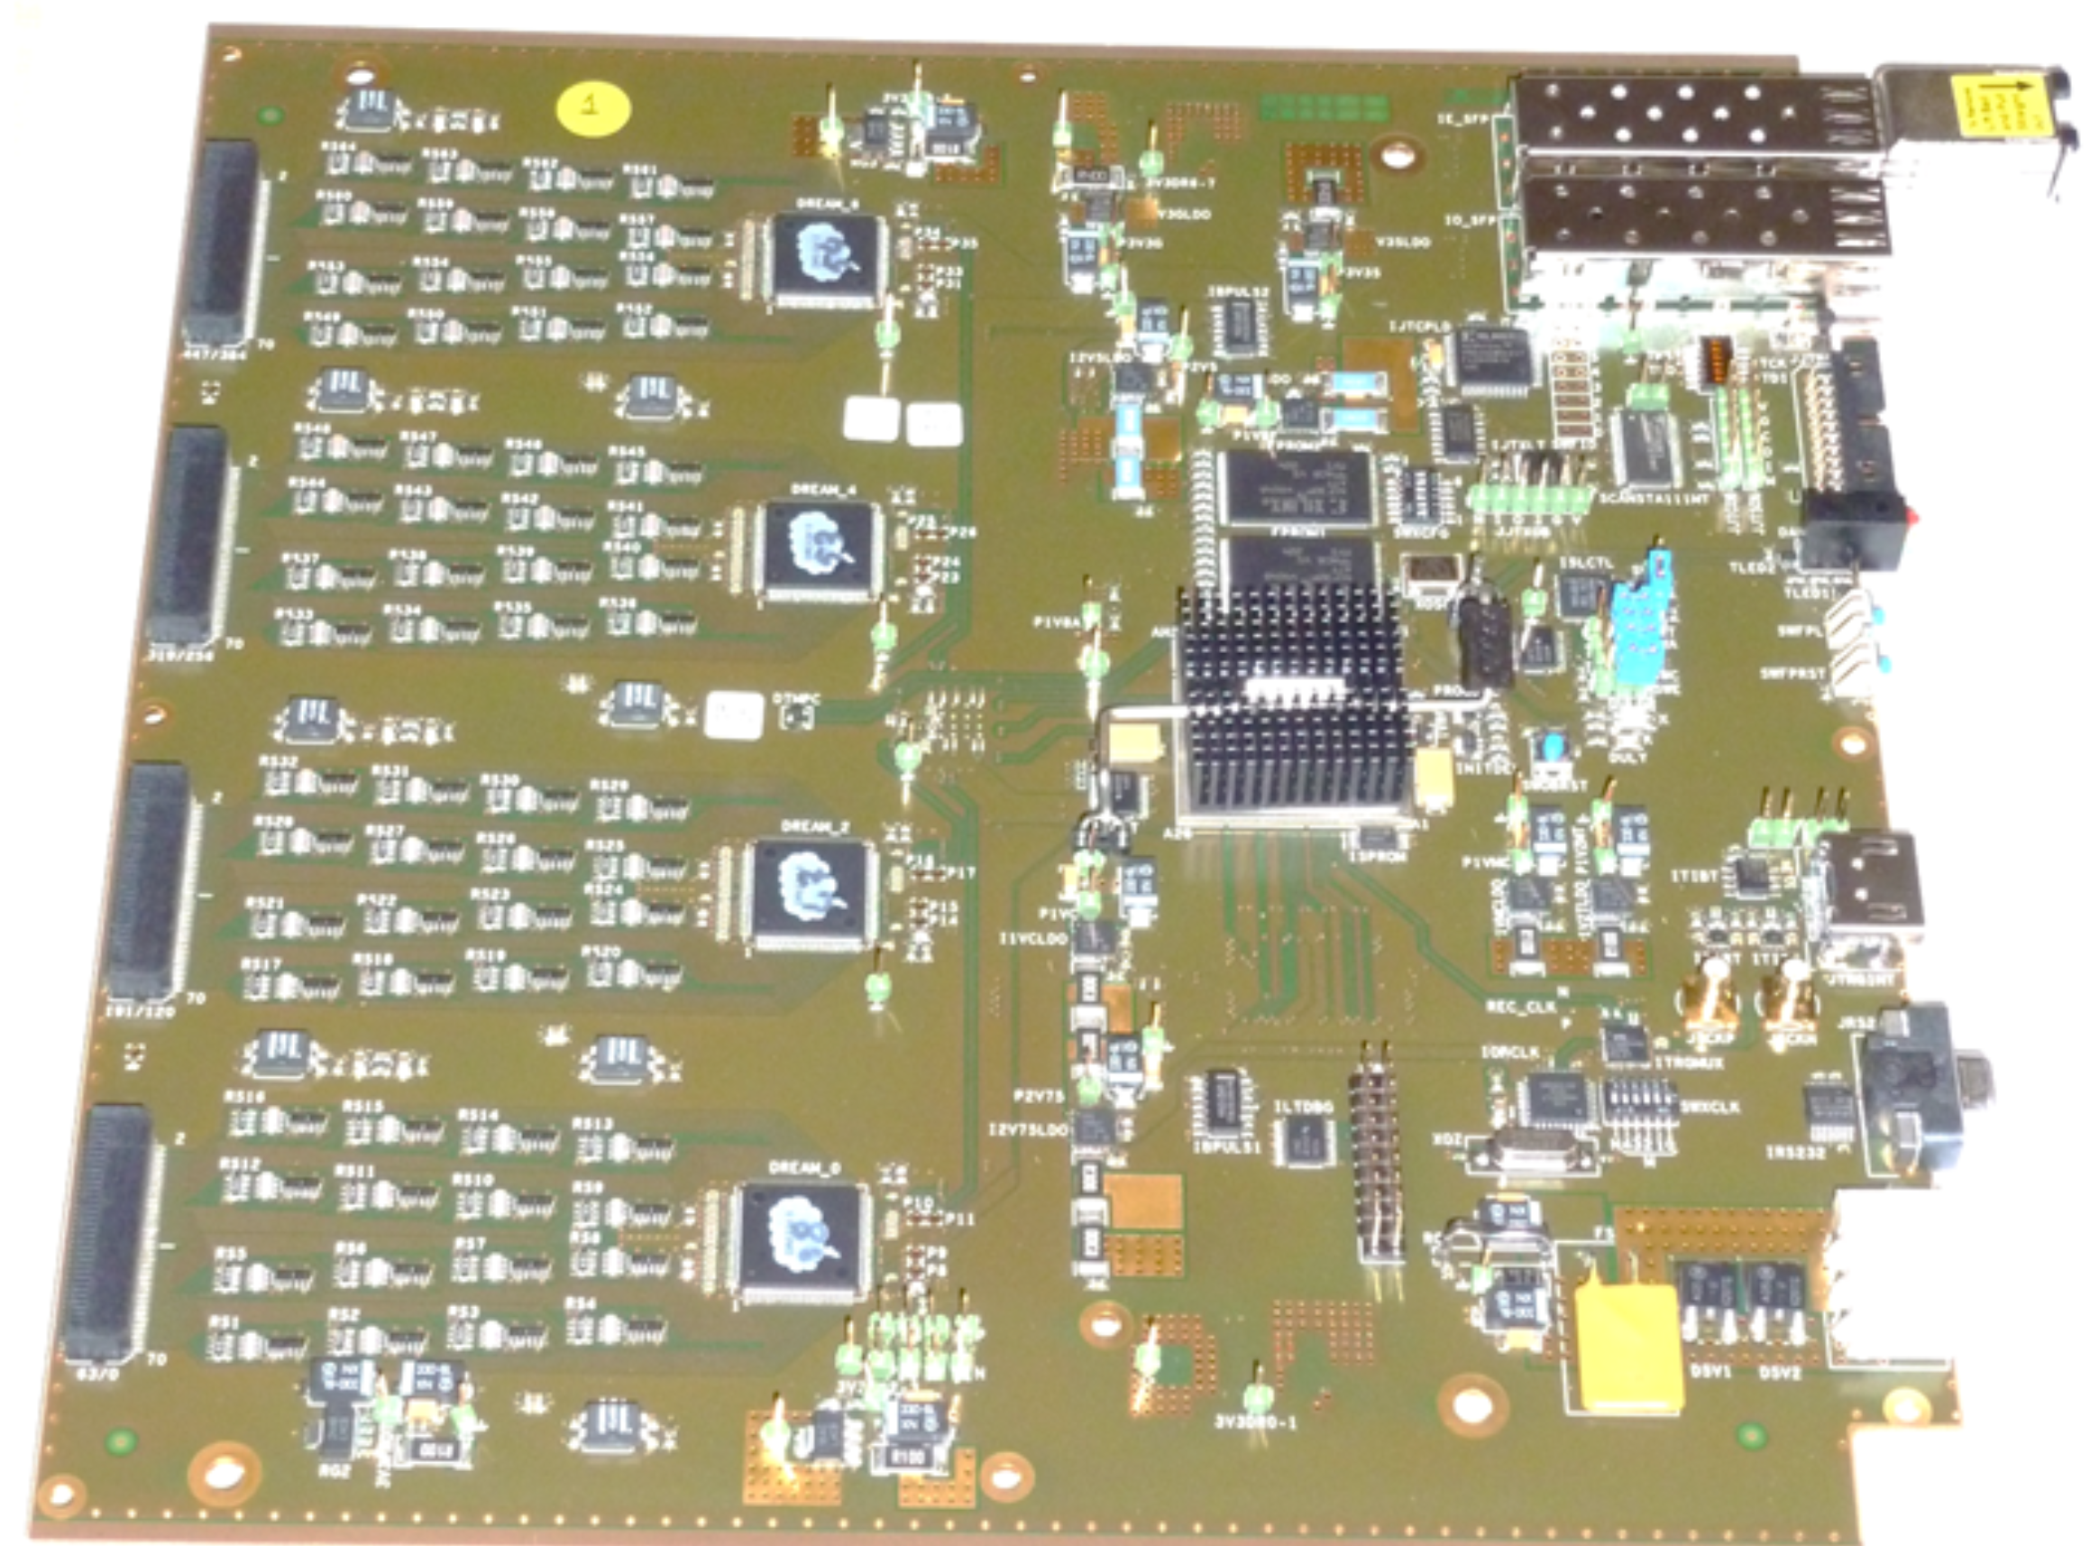
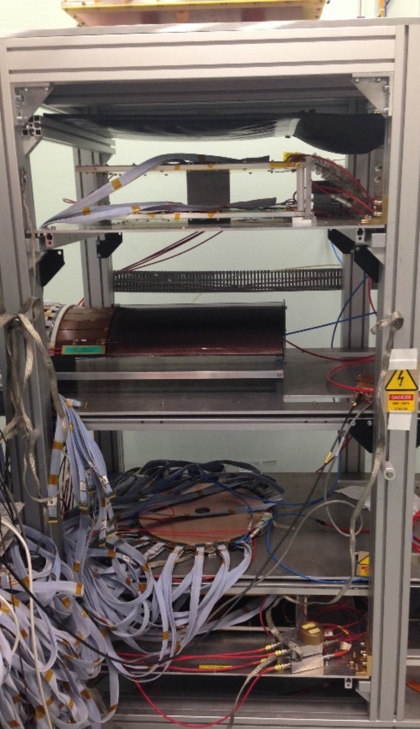
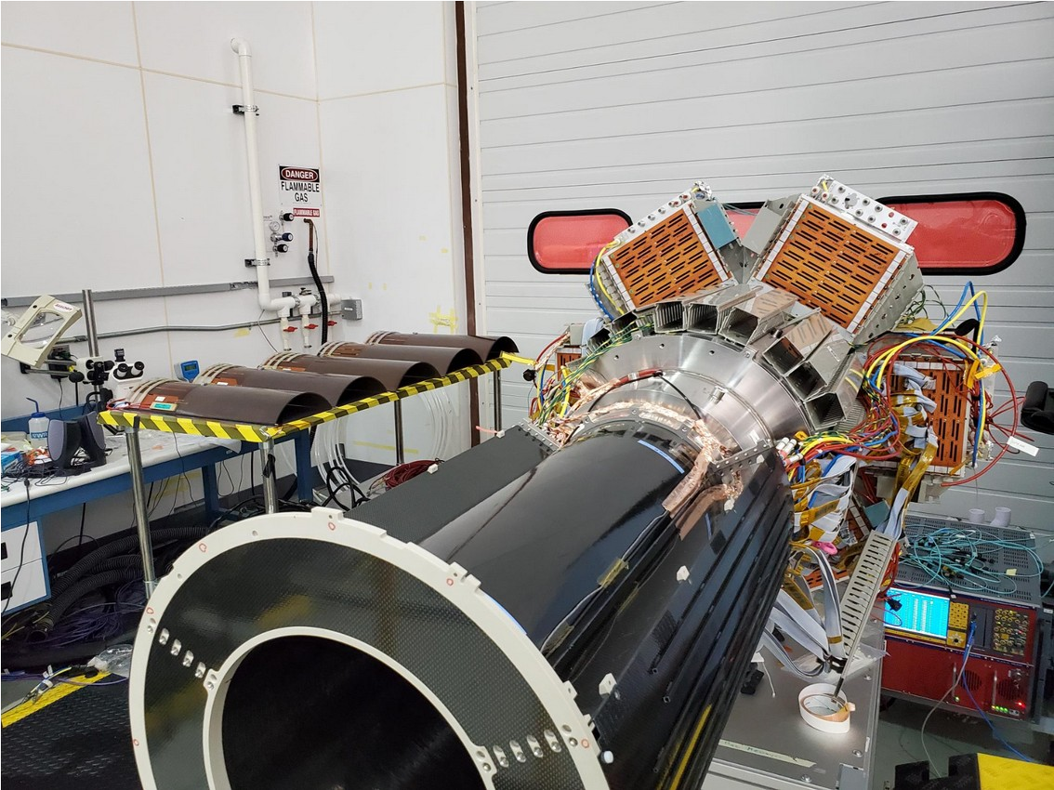
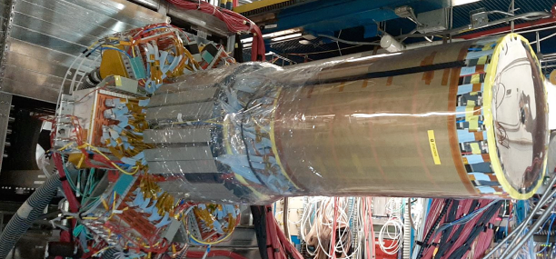
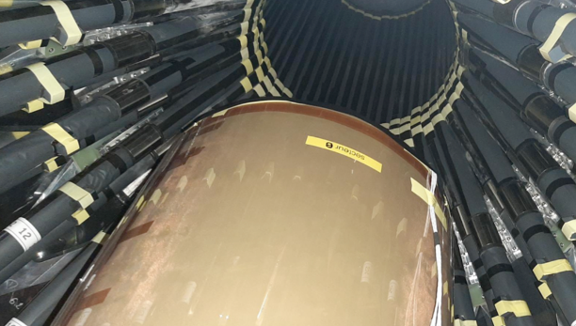
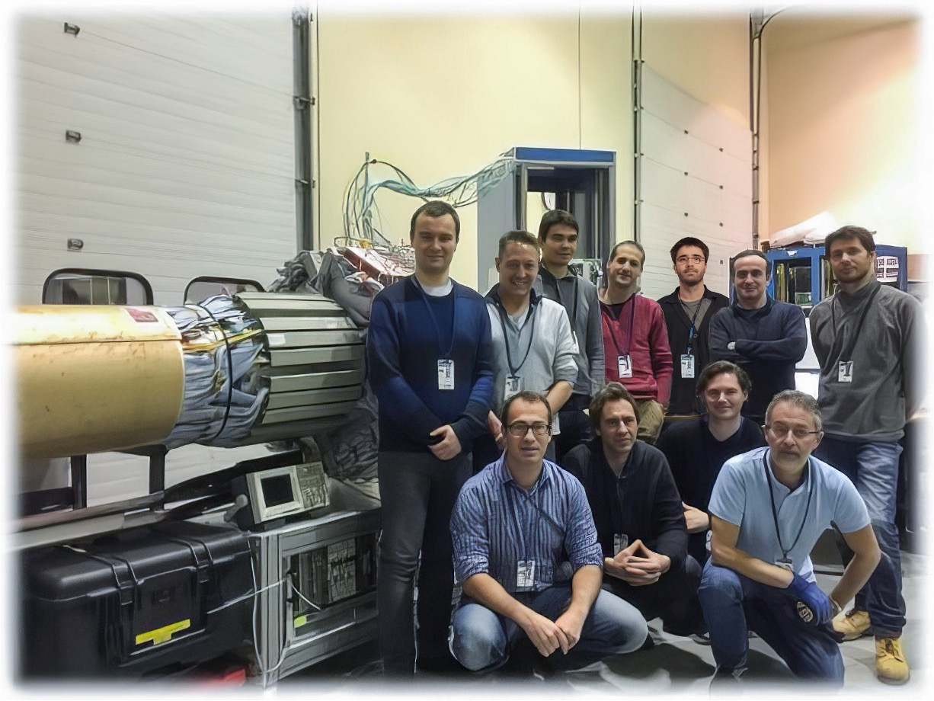
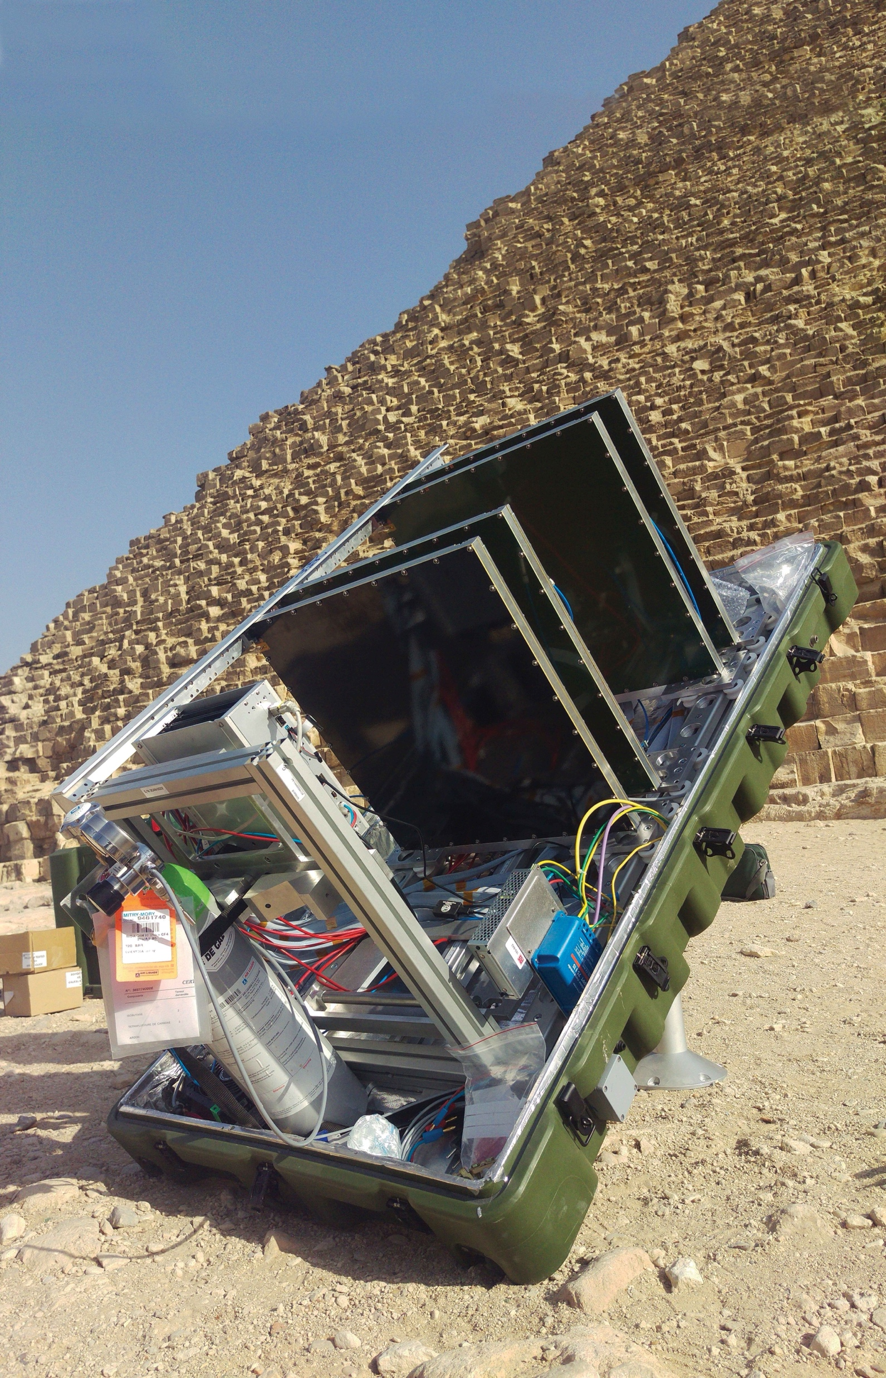
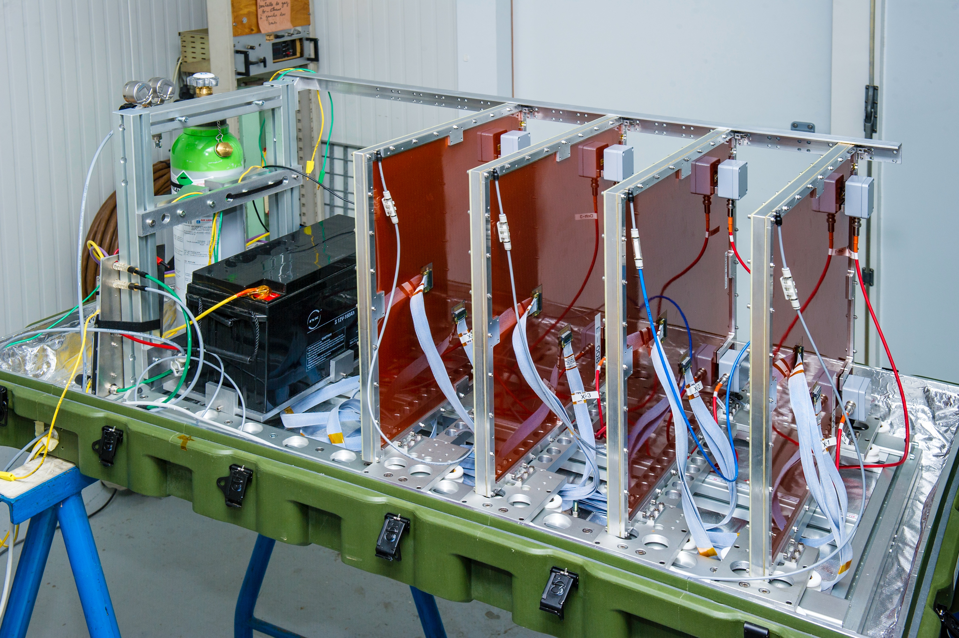
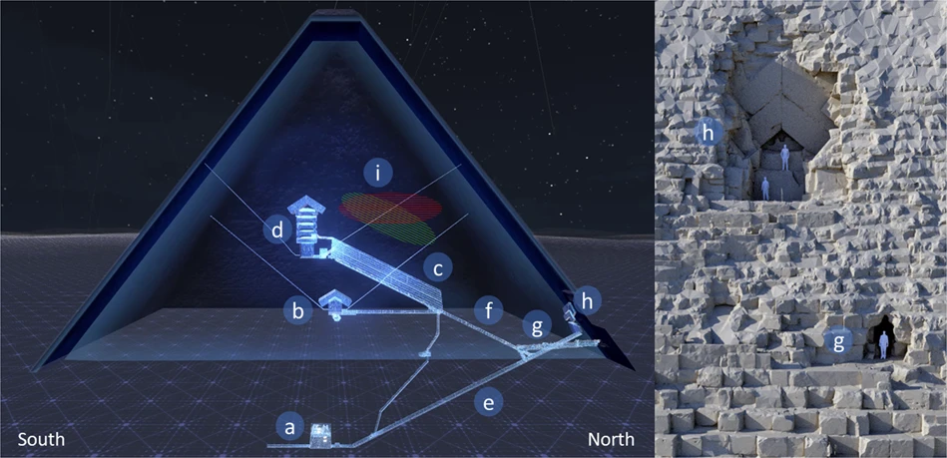
Micromegas Vertex Tracker (MVT)
Thomas Jefferson National Accelerator Facility
What is it?
MVT In Action
The Micromegas Vertex Tracker is used to determine the location of the nuclear collision by measuring directions and momenta of the charged particles produced in such collisions
Micromegas detectors are micro-pattern gaseous detectors. In a few-millimiter-wide conversion gap with high electric field, free electrons produced by the ionization of gas molecules by a charged particle are drifting towards an amplification gap, creating am electronic shower, collected by the readout strips.
Dedicated software process all the hit positions and ”reconstruct” the properties of the particle, like its charge and momentum.
Schematic view of a resistive Micromegas detector.
The Barrel Micromegas Tracker (BMT) consists of three sectors, six layers of cylindrical detectors, three with strips along the beam axis giving information about the azimuth angle of the particle and three with circular strips perpendicular to the beam axis to constrain the polar angle.
The Forward Micromegas Tracker (FMT) consists of six flat disks stacked together, assembled with a 60 degrees rotation, attached to the Barrel end flange.
The Forward Tagger Tracker (FTT) used for a precise determination of the scattered electron angle. It contains two double-layers of Micromegas detectors with perpendicularly oriented strips to determine the (X,Y) coordinates of a track.
A representation of a single collision recorded in October 2022.
We collect about 20000 of these events every second.
You can see the particles hitting various detectors, including the MVT (6 barrel layers in 3 sectors, red color).
The “clockwise tracks“ are positively charged particles. The counterclockwise are negatively charged particles.
2D map of the hits from the registered tracks in the Forward Micromegas disk demonstrating high hit detection efficiency.
3D view of the Micromegas Forward Tagger Tracker with front-end readout electronics.
Tech Specs
15360 channels in six BMT layers
6144 channels in six FMT disks
3072 channels in four FTT disks
Drift gap: 3 mm, amplification gap: 0.13 mm
Gas: Argon 93%, isobutane 7% (BMT)
Trigger dispersion below 1 ns
64 channels / readout chip (DREAM)
Data rate ~ 200 Mbits / s
Data readout clock: 125 MHz
Radiation hard design
State-of-the-art resistive strip detectors
Low material budget
Operation in 5 Tesla magnetic field
Tracking efficiency > 90 %
Momentum resolution < 5%
Angular resolution:
Polar < 10 - 20 mrad
Azimuthal ~5 mrad
2D map of the hits from the registered tracks in the Barrel Micromegas tile demonstrating high hit detection efficiency.
512-channel front-end readout board
Z position of the reconstructed vertices showing sub-millimeter resolution of the barrel Micromegas tracker.
Building and Installing the MVT
Did you know?
The Micromegas Vertex Tracker is built to operate in high magnetic field, (about 12 times stronger than what can erase credit cards, damage peacemakers, etc).
The particle rate is 30 millions per second and the system is reading over 20 thousands MVT channels all at the same time!
To register low-momentum particles the detectors must be very light to avoid multiple scattering which would change the properties of the track.
The whole sensitive area of the MVT is over 4 square meters.
Micromegas detectors were used to search for hidden cavities in the Egyptian pyramids!
Best in class: MVT is the first large-scale Micromegas tracker with resistive strip technology which allows for better separation of the signal from unwanted background noise. For the first time cylindrical detector geometry was used in the nuclear physics experiment.
The MVT, barrel and forward system, is ready to be inserted in the Central Time-Of-Flight system. Six crates on the left side contain readout electronics, connected to the detectors by flat cables.
Commissioning of the Forward Micromegas disks with cosmic test setup.
Assembly of the MVT. On the left side five barrel detectors are to be integrated. The building and assembling of the detector took place in a clean room with HEPA filtering of dust particles to protect the micromegas detectors.
The MVT is being installed into the central time of flight system.
Muon telescope during the system commissioning in Saclay.
Reconstructing cavities of the north-east edge of the Khufu’s pyramid by scanning rock density with muon telescope.
Contributing Institutions
CEA, Saclay, France
Jefferson Lab, Newport News, VA, USA
The CEA Micromegas team is celebrating assembling and commissioning of the MVT at Jefferson Lab.
Muography of the Giza’s Great Pyramid with Micromegas telescope.

